Slide 1


VISVESVARAYA TECHNOLOGICAL UNIVERSITY Jnana Sangama, Belagavi, Karnataka 590018. J N N College of Engineering Navule, Savalanga Road, Shivamogga, Karnataka 577204. Department of Master of Computer Applications Major Project Presentation on “Predicting the Quality of Fruit using Machine Learning" Submitted by KEERTHANA S N 4JN20MC013 For the academic year 2021-22 Under the Guidance of Dr Sunitha G P Associate Professor Dept of MCA, JNNCE, Shivamogga 2021-2022

Slide 2
ABSTRACT
Fruit recognition and checking the quality of fruit is beneficial for industrial purpose to identifying the fruit name and quality of the fruit. Using this technique, they can easily check the status of fruit like the fruit is low, medium and high ripen. This gives the fruit is ripen or not. Fruit quality is determined period of practical helpfulness in advance giving a price for fruit, quality checking and examining the fruit have more significance in several phases in process. The collected data from the test and train is by ML technique and the information is stored in storage. Whereas humans are capable of doing the evaluating as well as classifying but it is disagreeing, hour consuming, varying, individual, difficult, high cost and simply effected by environment. This presents a complete review of several techniques i.e., processed the image, acquisition, pre-processing, segmenting, extracting, classification this classify fruits quality based on colour, dimension, structure, figure and defect.

Slide 3
CONTENTS
Introduction
Prior-art
System Requirements
System Design
Results
Conclusion
References

Slide 4
INTRODUCTION
Fruit Recognition and ripen status is useful to the industrial purpose for recognising the fruit and checking the status of the fruit ripe. It is useful in fruit shop, market and malls to recognising the name of the fruit and categorise the fruit status like low, medium high. farming provides a living for more than 60% of the population. Nowadays, the growth of fruit productivity is usually influenced by quality. In the industrial field, quality is a major issue. Most fruits are low, medium and high ripe to classify the fruits and status of fruit with quality effected by the weather. This technique is used to determine the fruit status. To create a self-operating store the data to test the quality using the present system. This storage contains of information about fruit condition, recognition, and quality. The details of fruits and the status identified starting with the feature extraction are stored in the storage. The collection of data stores the details of the fruits and the status determined by feature extraction.

Slide 5
Motivation
It's now possible to go further in the agriculture industry thanks to the notion of "modern agriculture," which is not only beneficial but also essential. In the current scenario 70% more fruit production is required to support the world population full filling only 70% of the world still 30% more quality fruit production is required to meet the demand. This requires further to cultivate more forms to produce more food and utilize more land for production. Therefore, it is important to practise more effective forming on studying the soil, type of crop, water facility, identifying fertility of soil available in forms. To develop strategies to get better yields.

Slide 6
Problem Statement To design a system which automatically detect the quality of fruit using a machine learning model. Objectives 1. To identify the object using the Machine learning Model. 2. To design the CNN model for Quality prediction.

Slide 7
PRIOR-ART
PAPER | METHODOLOGY | MERITS | DEMERITS
1. | The CNN algorithm is used. | This improved the outcome of several scale fusions and productively solving the big scale target in checking the process. | This masking Region-based convolutional neural network fail to find the objects.
2. | In this paper the CNN algorithm is used. | Deep learning is well when there was a white collection of data used CNN algorithm in citrous fruits | The failure was associates in the year relates to the analysing, failed chart of the design with augmented data and pre-processing.
3. | This paper using the k-means clustering. | ML was provided the good result in the detecting and identifying of plant disease. | This was simply to loss in two local optimums in big dimension space.
4. | The ANN algorithm is used. | Most thresholds value is remain the big accuracy of histogram results in leaves and fruits. | This provides more bulk of data to performed good than the a few technologies.

Slide 8
SYSTEM REQUIREMENTS
HARDWARE AND SOFTWARE REQUIREMENTS
Hardware Requirement:
The minimum hardware requirements for the proposed system are listed as follows
Pentium 4 Processor
2GB RAM
80 HDD
Software Requirement:
The software requirement for the proposed system is listed as follows
Python 3.5
The libraries used are Numpy, Pandas, OpenCV, TensorFlow, Keras.

Slide 9











SYSTEM DESIGN
In this below diagram explained about the working flow of diagram is labelling, acquisition of image, pre-processing images, extracting the features, classified result
Flow of diagram
Label
Loss
Function
Train Stage
Training
Pre
Feature
CNN
Predict
Dataset
Processing
Extraction
model
Test stage
Testing
Pre
Feature
CNN
Classificatio
Dataset
Processing
Extraction
n
Result

Slide 10
Firstly, we labelling the different fruits. The categorization of fruit based on the fruit type on the different folders. After the label. The training dataset we read the image using the get data set and after this list the map importing the class as intake. To create model into RGB colour. Acquisition of image The image acquisition for obtaining an image starting with computer or coming out of a storage of fruits data set is referred to as image acquisition. The picture was taken in the web cam or a regular picture from the already stored data. The images are capturing using the webcam and images are stored in the training data set. In the below figure shows the capturing images.

Slide 11
In the pre-processing pictures are collected, It is upgrading the input image, which includes noise removal and size clarifying to improve the picture. In our project used the im_read, im_shape, im_resize, color_bgr2gray.In the below figure explained about the preprocessing process firstly, The images are taken as input and applying the filter. After the filtering. Its converts the colour image to grey scale conversion and removing the noise. To detect the edge and given the pre processed output.
The next stage is extracting the feature. In process of enhancing snaps to better depict visually appealing elements is known as feature extraction. The input photos are examined for properties like spots, colour, form, and area, among others. We plan to leverage colour features including standard deviation, distribution of frequency, distort, collection of prominence, and collection of shade since colour may distinguish one disease from another.

Slide 12
It is primarily done to reduce the difficulty of processing the photos. The quality is recognised placed on the colour and shaping the behaviours that specify the bug in the fruit photos. After the extracting, CNN based networks (CNNs) are currently a more general class of models for classifying and recognising images, according to the CNN categorization. The main benefit of CNN is that, in comparison to other classifying algorithms, it requires much less pre-processing time. It processes the incoming data, trains the model, and then quickly prepares the crucial data to improve the sorting process.

Slide 13
CNN Algorithm Step1: Fruits Image are stored in the different folders. Step2: The labelled folder is subjected for CNN model creation. Step3: By 6 layers of relu layer to develop CNN model. Step4: Convolutional 2 dimension and max pooling, white spreading and flattening are carried out to make model strong. Step5: By giving input image to already existed model we can able to forecast the class of the predicted image.

Slide 14
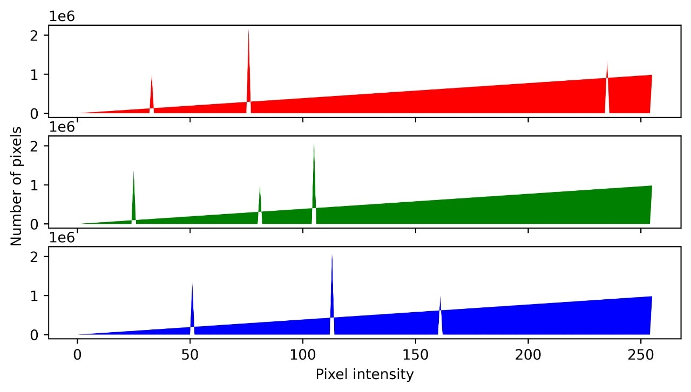
RESULTS
The analysis is performed on the histogram which represents the colour distribution which is used to classify the quality of low, medium and high.
Colour distribution graph

Slide 15
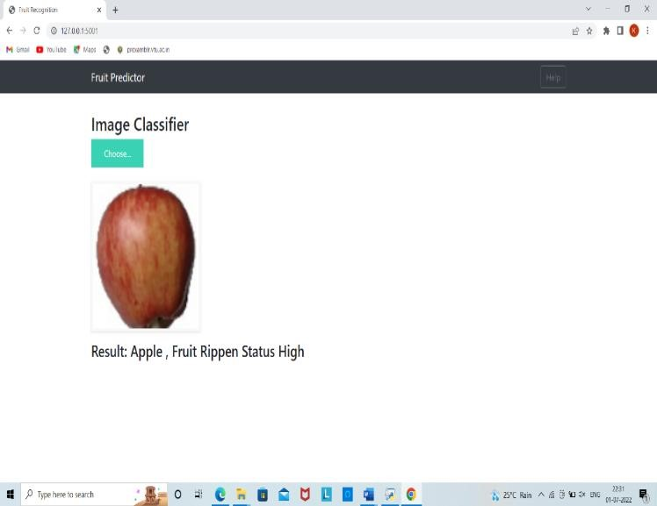
In this below figure it will recognised the fruit and the status of the fruit like high, medium and low. It gave the result of the fruit is Apple and the status of the fruit is high. Fruit recognition and status of apple

Slide 16
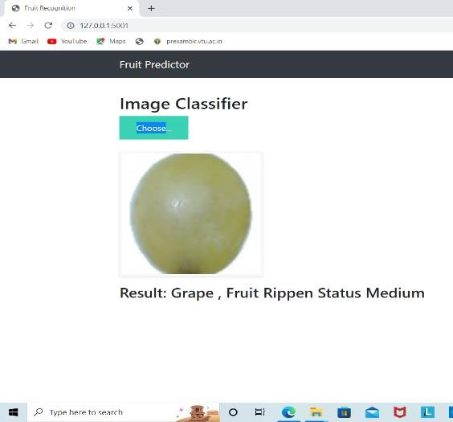
In this below figure it will recognized the fruit and the status of the fruit like high, medium and low. It gave the result of the fruit is Grape and the status of the fruit is medium. Fruit recognition and status of a Grape

Slide 17
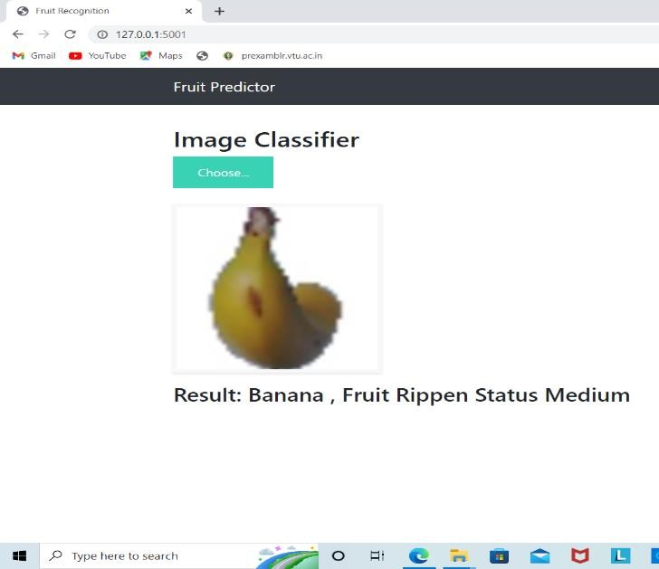
In this below figure it will recognized the fruit and the status of the fruit like high, medium and low. It given the result of the fruit is Banana and the status of the fruit is medium. Fruit recognition and status of Banana

Slide 18
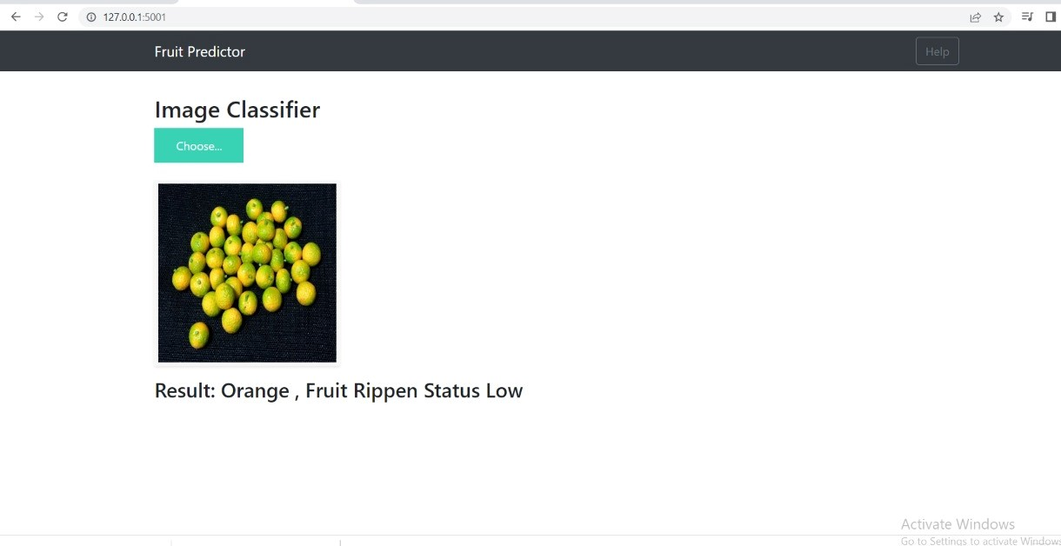
In this below figure it will recognized the fruit and the status of the fruit like high, medium and low. It gave the result of the fruit is Orange and the status of the fruit is low. Fruit recognition and status of orange

Slide 19
CONCLUSION
The creation of a fruit recognition and status system for the benefit of market, mall, wholesale fruit shop and industries for the better predicting the of quality details, which helps for eliminating the collecting as well as encourage the development of a prosperous, secure, and tranquil farmer society in India. The CNN technique was used to classify and segment fruit image data. Initially, the various attributes of a few fruits were retrieved and the corresponding photos were segmented. The various quality names are compared to feature values after which the best quality for the image is determined. This quality is then highlighted by an alert box. The result is displayed together with the overall sample count, low, middle, and high locations. The overall paper shows the fruit recognition, status, ripe and quality of the fruit.

Slide 20
THANK YOU

